Slide 1

Quick Test Professional Web Service Validation
Presenter Name:
Deloitte Consulting LLP
Date:

Slide 2
Agenda
Introduction to Web Services
Overview of Web Services
Components of Web Services
Introduction to API Testing using UFT
Create a sample API Test using UFT
Data Driven API Testing
Parameterize Request Parameters
Execute Sample Request and Validate Response
Response Parsing
Parametrizing Responses
Checkpoints
Q&A

Slide 3
Introduction to Web Services

Slide 4
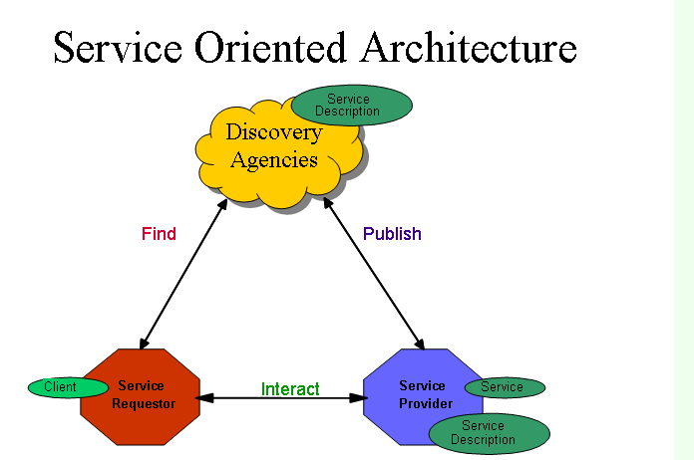
Web Service Overview
The term "web service" is often used to describe a service that a client (a computer) can call remotely over the internet, via web protocols like HTTP. Like calling a method, procedure or function which is running on a different machine than the client. As such web services are very similar to "remote procedure call" (or just "remoting") protocols, like Java's RMI, Windows DCOM, Corba's IIOP etc. The basic web service principle is illustrated below:

Slide 5
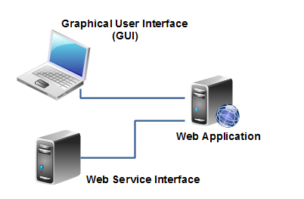
Web Services vs. Websites / Web Applications
The main difference between a web service and a web site is, that a web site is typically intended for human consumption (human-to-computer interaction), whereas web services are typically intended for computer-to-computer interaction.
Of course this distinction is somewhat blurred. A web application can contain both a graphical user interface for human users, as well as a set of web services for computer "users" (clients). For instance, a payment service like Paypal has both a graphical user interface for human users, as well as a set of web services through which you can have your own backend systems access the Paypal services.
This illustration shows a web application that contains both a graphical user interface, and a web service interface (a set of web services exposing selected functions of the web application):

Slide 6
WebService Components
SOAP
SOAP is an XML-based protocol for exchanging information between computers.
SOAP is for communication between applications.
SOAP is a format for sending messages.
SOAP is platform, language independent.
SOAP is language independent.
SOAP is simple and extensible.
WSDL
WSDL is an XML-based language for describing web services and how to access them.
WSDL stands for Web Services Description Language.
WSDL definition describes how to access a web service and what operations it will perform.
WSDL is a language for describing how to interface with XML-based services.
UDDI
UDDI is an XML-based standard for describing, publishing, and finding web services.
UDDI stands for Universal Description, Discovery, and Integration.
UDDI is a specification for a distributed registry of web services.
UDDI can communicate via SOAP, CORBA, and Java RMI Protocol.
UDDI uses WSDL to describe interfaces to web services.

Slide 7
Introduction to API Testing using UFT

Slide 8
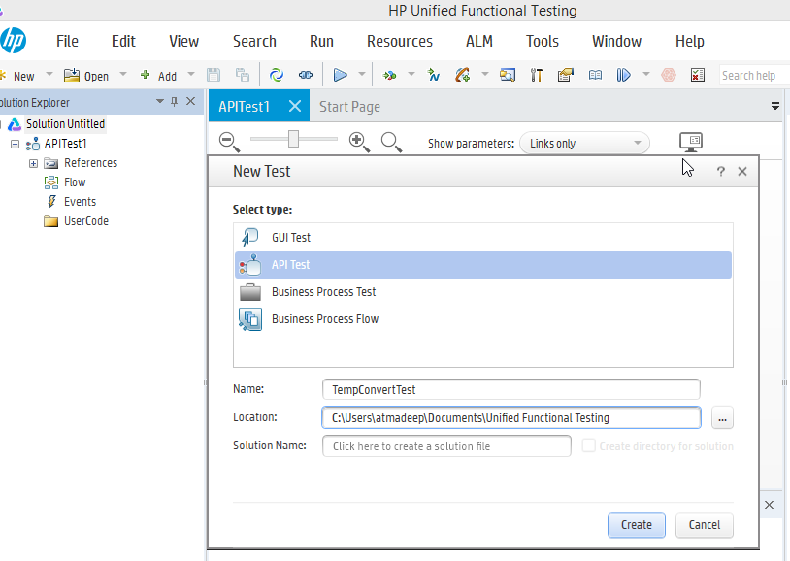
Creating Web Service Test
Step 1:
Navigate to New Test
To Create an API Test, Select File > New >Test >API Test and name the test
Click on Create.

Slide 9
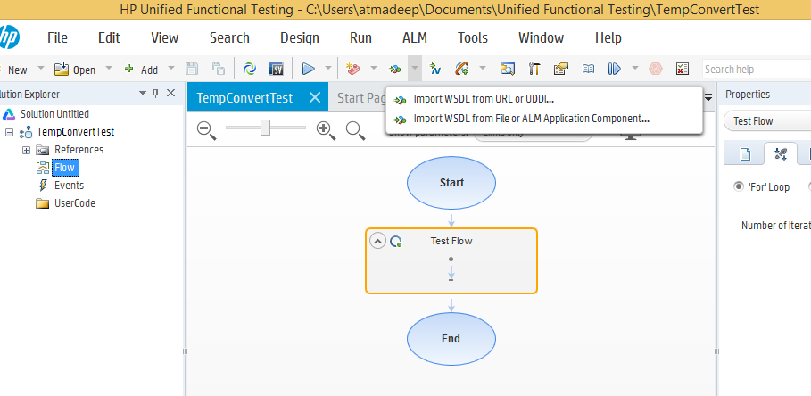
Creating Web Service Test
Step 2:
Click on Import WSDL icon on UFT Tool Bar
We have 2 options:
Import WSDL from URL or UDDI – Select this option to import WSDL from URL
Import WSDL from File or ALM Application Component – Select this option, if you have the WSDL file or from ALM

Slide 10
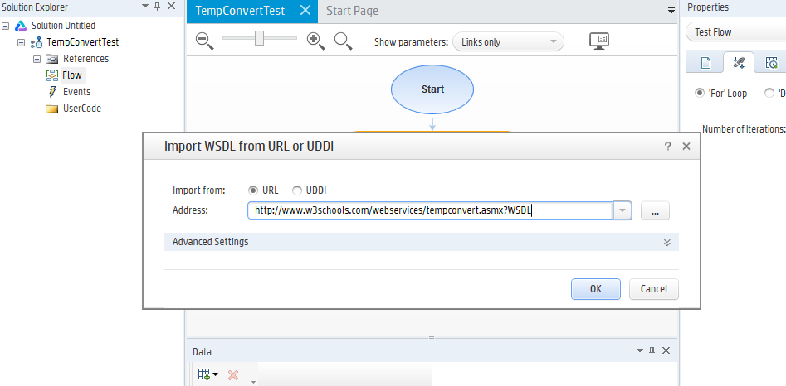
Creating Web Service Test
Step3:
Enter the WSDL url mentioned you want to test in the Address field and Select URL option and Click OK to proceed.

Slide 11
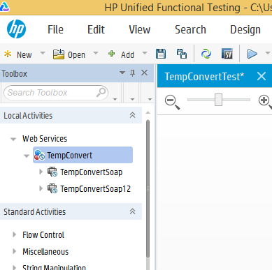
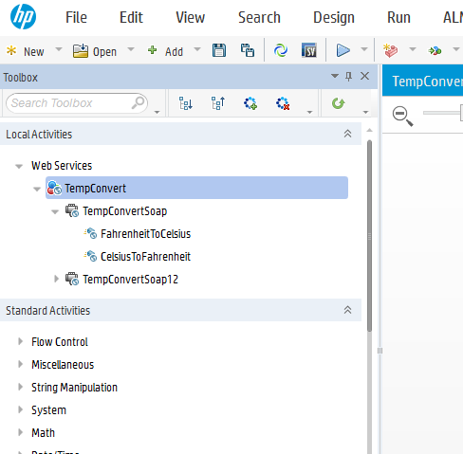
Creating Web Service Test
Step 4
UFT imports and read the methods and parameters of web service to work with. You can find all the methods or operations of web services at the ToolBox pane under Local Activities. In this case, you will find two operations under TempConvert Service as in the snapshot below. These operations can be used to test the web service.

Slide 12
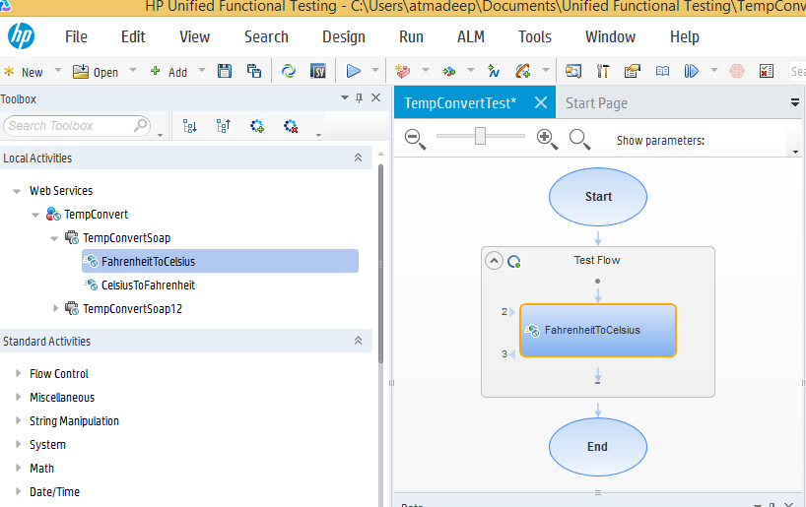
Creating Web Service Test
Step 5:
To use an operation to test, we just need to drag the operation from Local Activities area and drop onto the canvas area under test flow

Slide 13
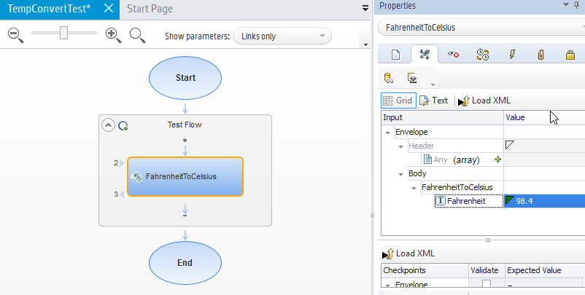
Creating Web Service Test
Step 6:
The methods require input parameters which are displayed under Properties Pane,Input/Checkpoints tabs.
Enter a value for the input parameters

Slide 14
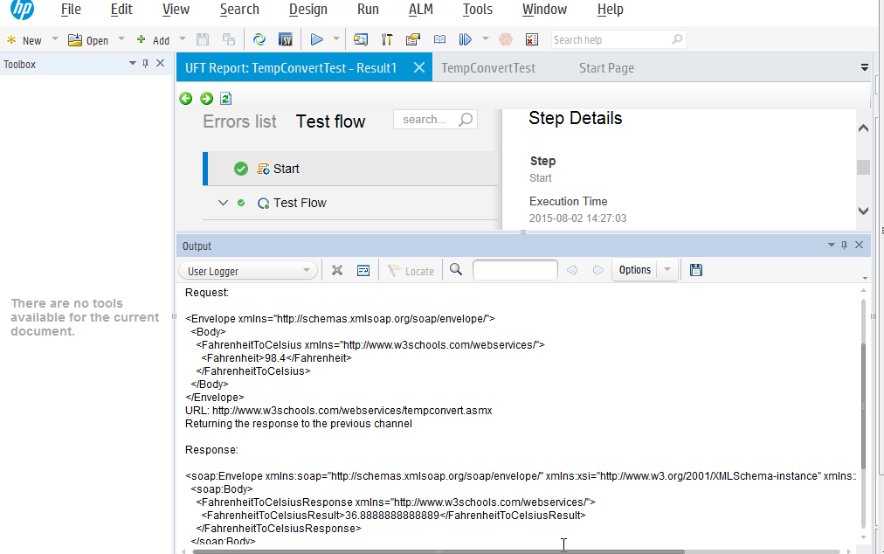
Creating Web Service Test
Step 7:
Create the request by passing value for different input parameters as required
Execute the test
Validate the response

Slide 15
Data Driven Testing

Slide 16
Data Driven Testing – Web Services
Data driving is the assigning of data to test steps from a data source, such as an Excel or XML file, database, or local table. The goal of data driving is to run the same business process with different values. It allows you to check your application in different scenarios, by modifying only the data tables.
Goal of Data Driven Testing for Web Services is :
To parameterize input parameters from suitable data source
To validate the request with multiple data sets rather than single hard coded input
To validate error handling with both positive and negative data inputs
To enhance maintainability of the tests as any changes in data can be made in the datasheet rather than the test
To keep the code and data separate and loosely coupled
The response/checkpoint from the web service can also be parameterized, It helps to parametrize both request and response thus promoting modularity, maintainability and usability

Slide 17
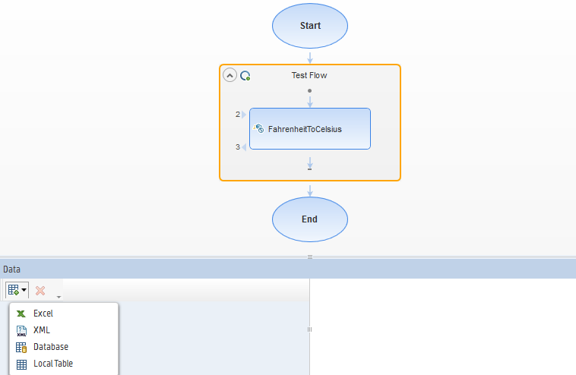
Data Driven Web Service Testing
Step 1:
From UFT Menu, click on View-→Data
Click on View Data Source and select a desired Data Source. In this example, we will select Excel

Slide 18
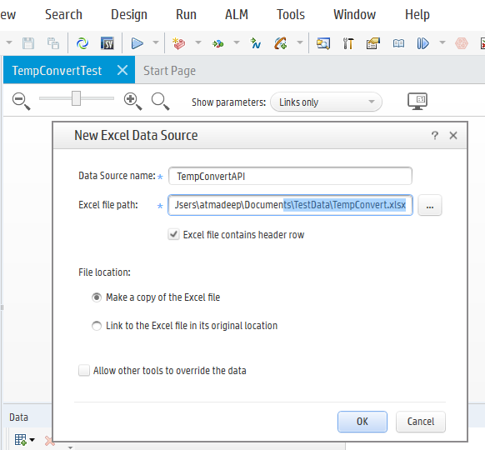
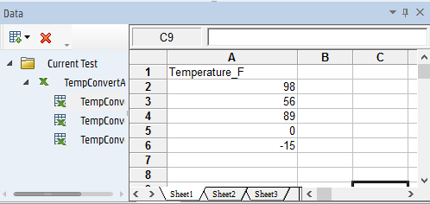
Data Driven Web Service Testing
Step 2:
In the New Excel Data Source’s Excel file path point to the TestData Sheet created earlier for this test case
Make sure that you select the Allow other tools to override the data option. Click OK

Slide 19
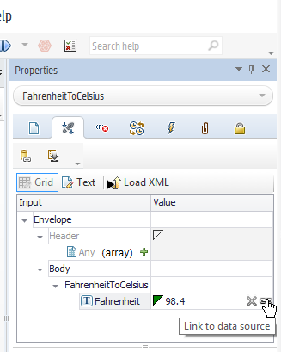
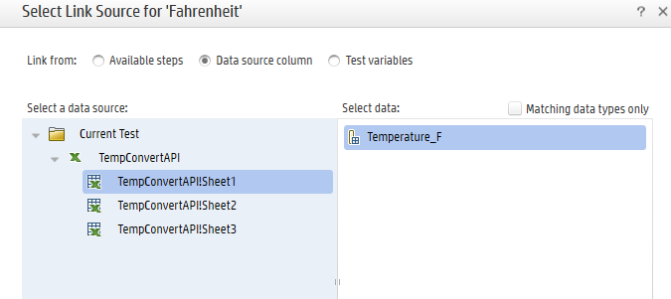
Data Driven Web Service Testing
Step 3:
Click on input parameters Properties Inputs icon
Link the Input parameter to corresponding Data Source Column

Slide 20
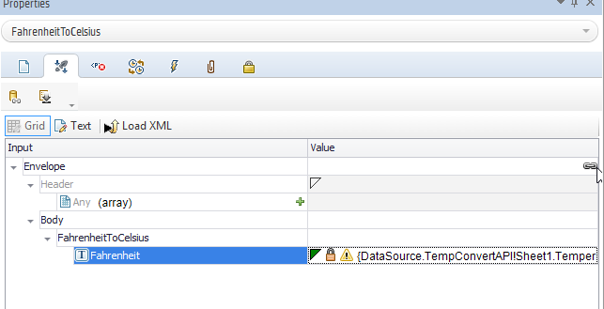
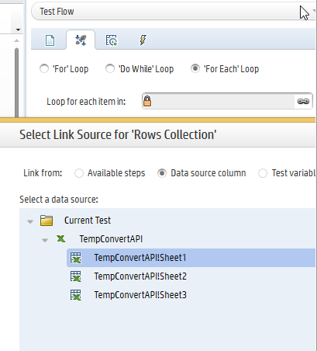
Data Driven Web Service Testing
Step 4:
Complete Linking of Input Parameters to appropriate Columns in Data Source
Update the Properties in Test Flow to iterate over each element in data sheet
Link the data source to the loop item

Slide 21
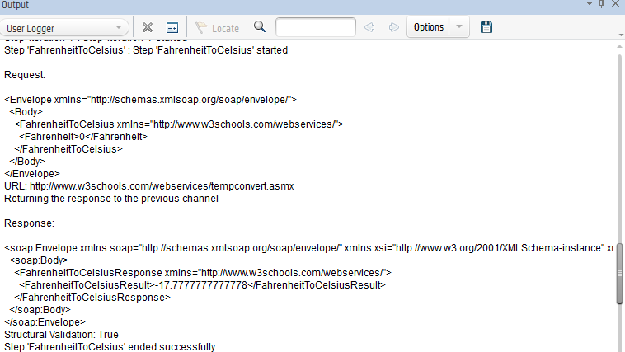
Data Driven Web Service Testing
Step 5:
Validate the SOAP request and response for each data set in the Output Window

Slide 22
Output Response Parsing

Slide 23
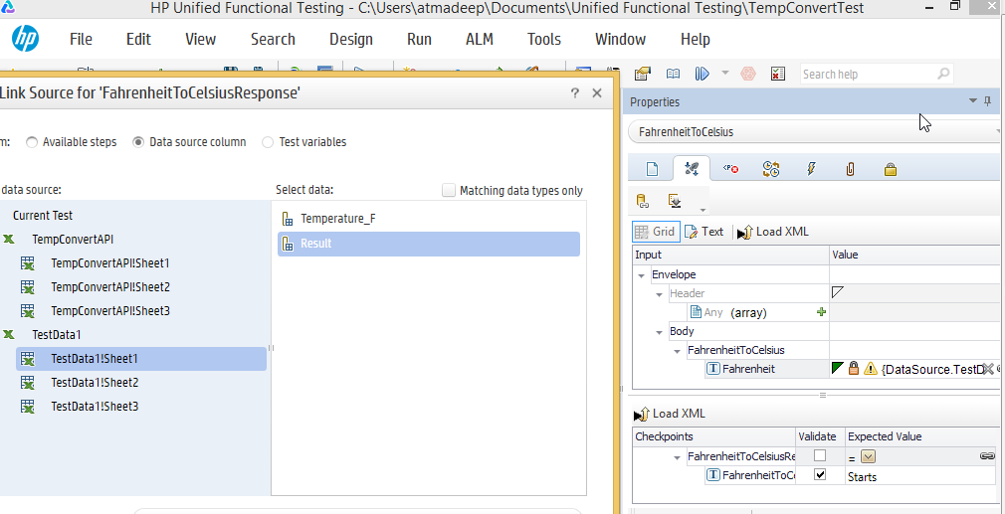
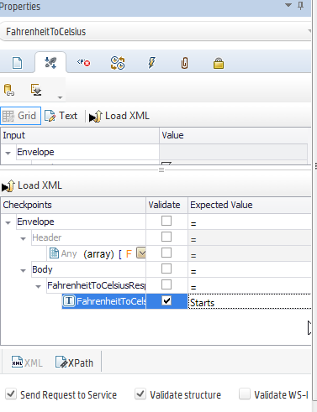
Response Validation
Step 1:
Provide expected values of output Parameters in the Checkpoints section in Properties Panel.
The values can be hard coded or parameterized as shown below

Slide 24
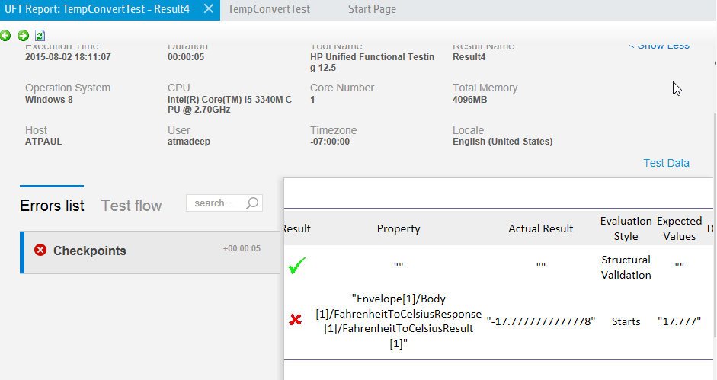
Response Validation
Step 2:
Re-run the same test and validate the responses for newly created check points
Validate the checkpoints in run result, if the expected values for response parameters doesn’t match with actual values, test case will be marked as Fail

Slide 25
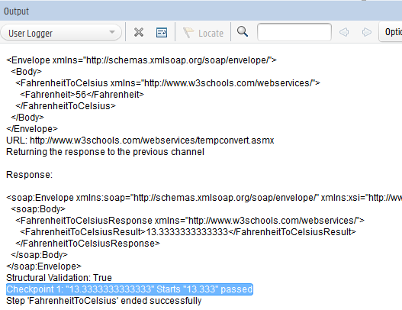
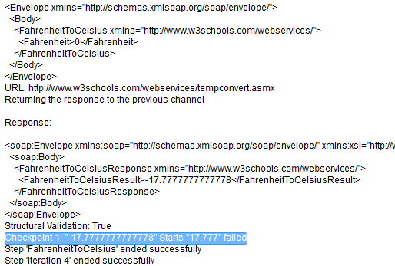
Response Validation
Step 3:
Validate output logger for all iterations and check the checkpoint results for success and failures

Slide 26
Q&A

